Slide 1


Center for Development of Advance Computing
Advance Certification Course – High Performance Computing
Batch : August 2025
Project Topic
Distributed AI Model Training Using MPI & GPU Acceleration
TITLE – CLEAN STREET PORTAL
Members Name
Aishwarya Wankhade - 250840150003
Nikita Nasare - 250840150021
Prajwal Chaudhari - 250840150026
Shruti Martode - 250840150036
Srushti Patil - 250840150040
Project Guide: Mr. Sanjay Sane Sir
Miss. Pratiksha Gacche (Course Coordinator)

Slide 2
Outline
Introduction
Problem Statement
Objective
Hardware and Software Requirements
Architecture Diagram
Time Analysis/Comparison
Inferencing
Project Screenshot
Future Scope
Conclusion
References

Slide 3
Introduction
Deep learning models require high computational power due to large datasets and complex architectures.
Serial training on a single CPU or GPU is time-consuming and inefficient.
Distributed training enables faster model convergence by parallelizing computation.
This project focuses on distributed image classification using MobileNetV2 on CIFAR-10.
MPI and PyTorch Distributed Data Parallel (DDP) are used on an HPC environment.

Slide 4
Problem Statement
Training deep learning models for image classification requires high computational resources.
Serial training on CPU or a single GPU leads to long training times.
Serial approaches fail to efficiently utilize available hardware resources.
As model complexity increases, scalability becomes a major challenge.
There is a need for a distributed training approach to reduce execution time.
GPU acceleration combined with MPI-based distributed computing can address these limitations.
The problem is to design and evaluate a scalable distributed training framework that
maintains accuracy while improving performance.

Slide 5
Objective
To develop an efficient image classification system using the MobileNetV2 architecture on the CIFAR-10 dataset.
To implement serial training on CPU and single-GPU environments to establish baseline performance metrics.
To design and implement distributed multi-GPU training using MPI and PyTorch Distributed Data Parallel (DDP).
To analyze and compare training time, scalability, and accuracy between serial and distributed execution modes.
To deploy the trained model using a user-friendly inference interface for real-time image classification.
To demonstrate the effective use of HPC infrastructure for scalable and high-performance AI model training.

Slide 6
Hardware and Software Requirement
Hardware Requirement :
PARAM Utkarsh Supercomputer
Software Requirement :
Linux Operating System , Python 3.x , PyTorch , TorchVision , MPI , Anaconda3 , Gradio

Slide 7
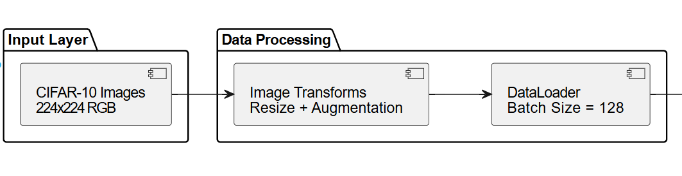
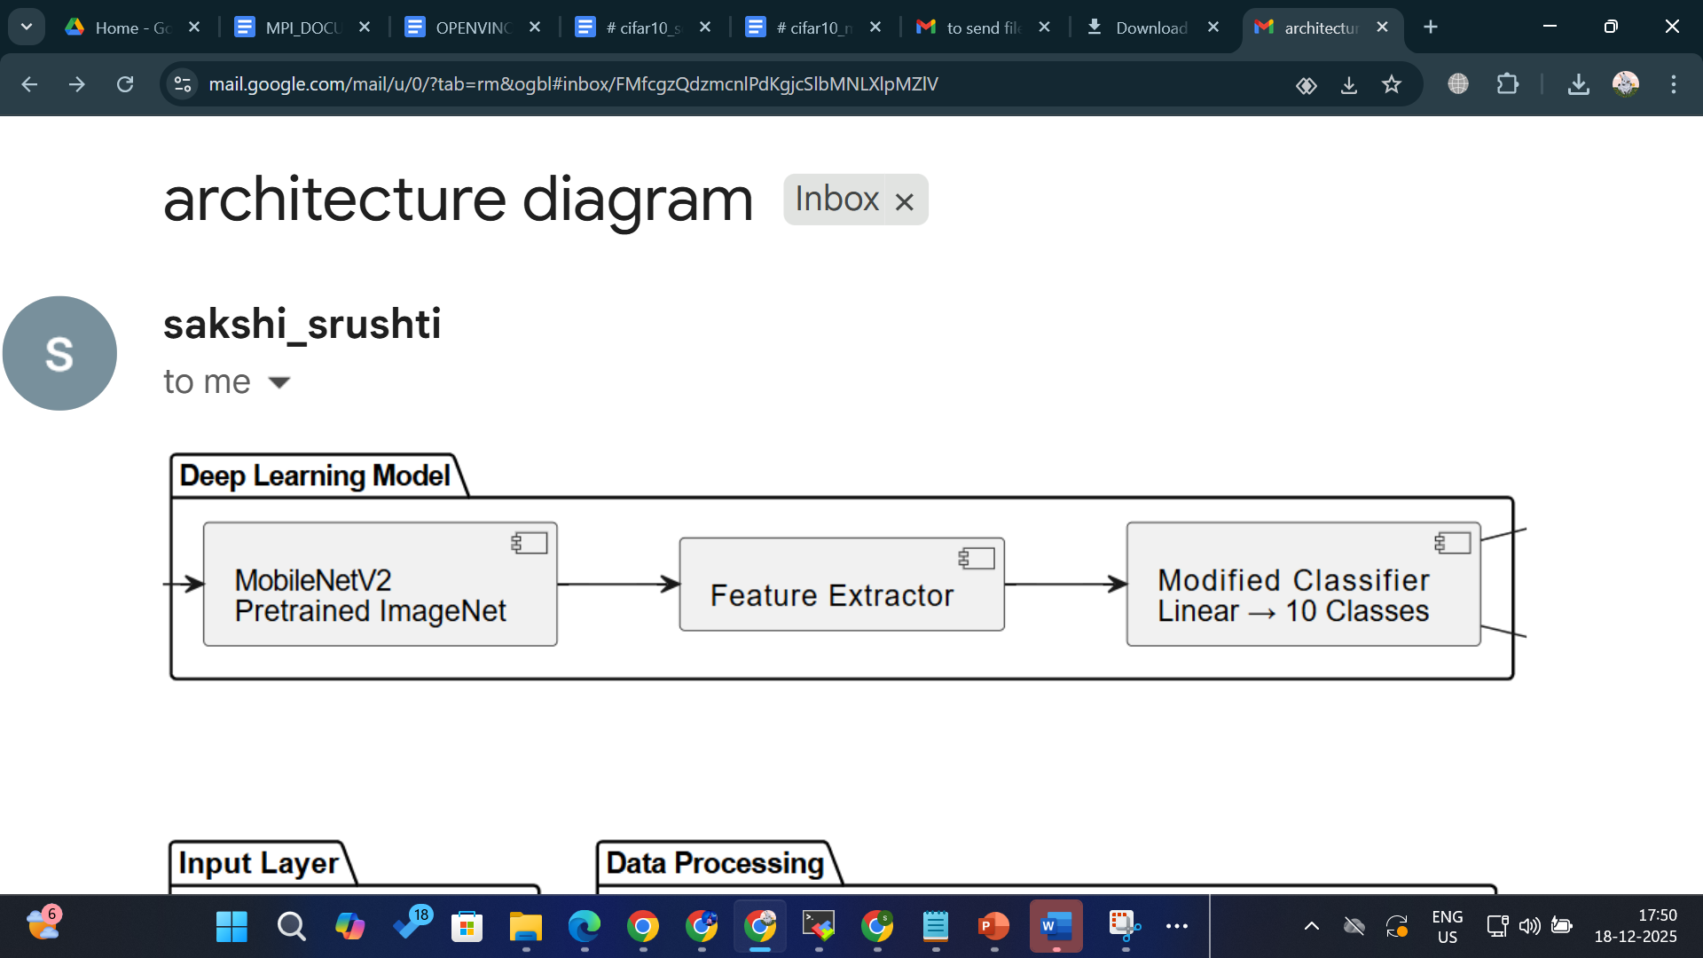
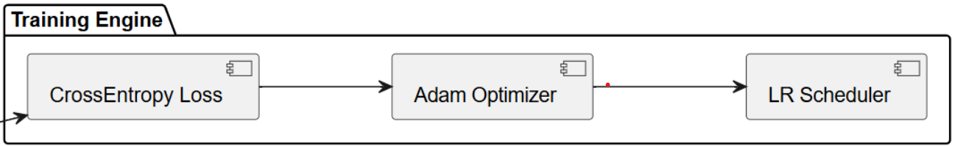
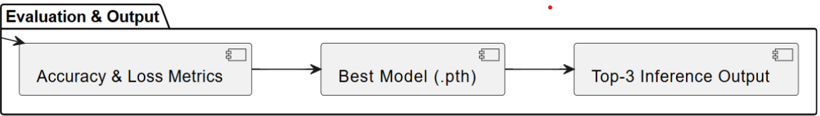
Architecture Diagram

Slide 8
CPU serial execution
Image size: Images resized from 32×32 → 224×224
Data augmentation (training): Random crop, flip, color change, rotation
Normalization: ImageNet mean and standard deviation
Deep learning framework: PyTorch
Model: MobileNetV2 (pretrained on ImageNet)
Transfer learning: Final layer changed from 1000 → 10 classes
Loss function: CrossEntropyLoss
Optimizer: Adam optimizer (learning rate = 0.0001)
Learning rate scheduler: StepLR (reduces LR after every 10 epochs)
Batch size: 128
Training type: Serial training (single process, no MPI/DDP)

Slide 9
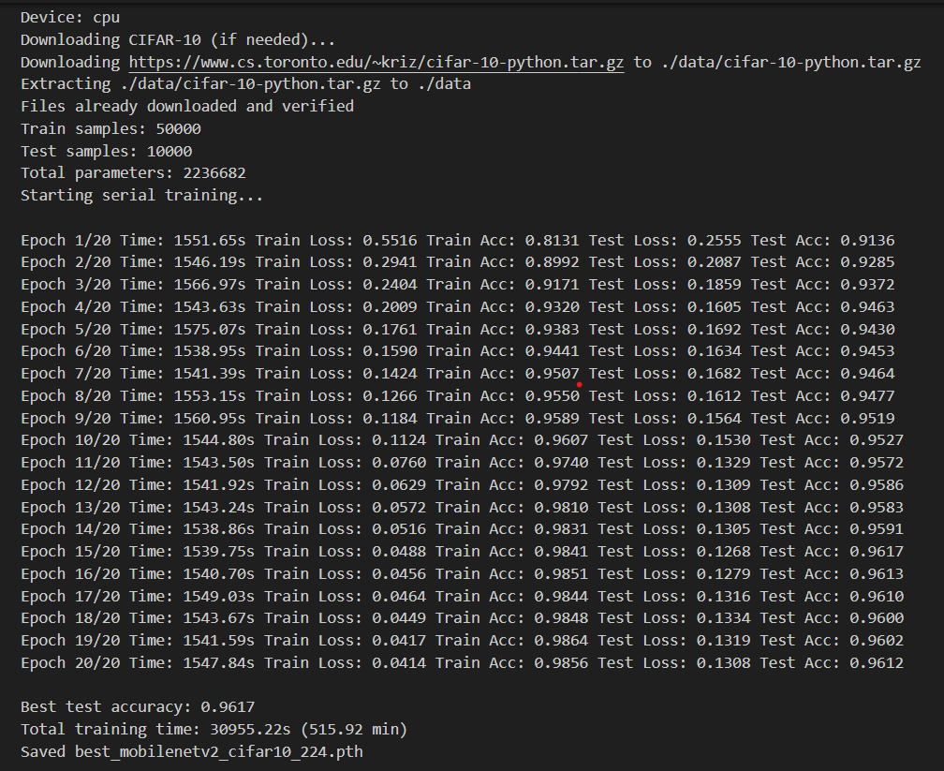
CPU Serial

Slide 10
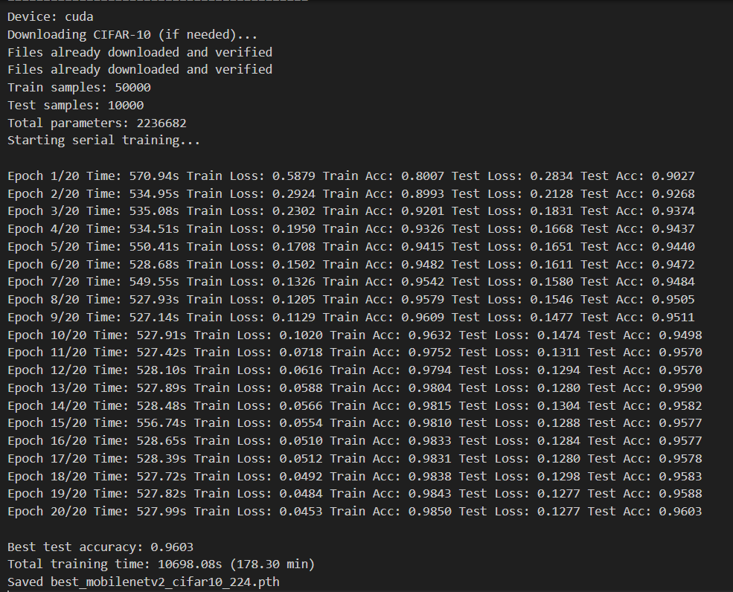
GPU

Slide 11
Distributed execution
Deep learning framework
PyTorch
Parallel / distributed framework
MPI (mpi4py) for multi-process execution
PyTorch Distributed Data Parallel (DDP) for synchronized training
Distributed setup
Multiple processes (ranks)
Each rank trains on a different data shard
Gradients are synchronized across ranks
Backend:
NCCL (if GPU available)
GLOO (if CPU)
Model
MobileNetV2
Pretrained on ImageNet
Transfer learning
Final classifier changed from 1000 classes → 10 classes

Slide 12
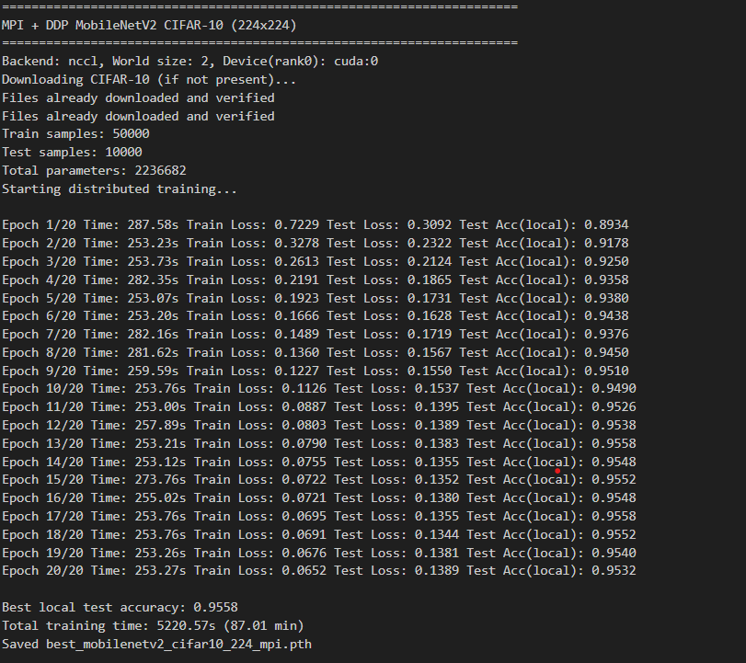
MPI+DDP CIFAR-10(224 x 224)

Slide 13
Time Analysis / Comparison
Execution Mode | Hardware | Training Time (Minutes) | Accuracy
CPU (Serial) | Single CPU | 515.92 | 96.17%
GPU (Serial) | Single GPU | 178.30 | 96.03%
Distributed GPU | 2 GPUs (MPI) | 87.01 | 95.58%
Distributed training provides ~6× speedup compared to CPU.
Accuracy remains comparable across all modes.

Slide 14
Future Scope
Species-Level Classification: Extend the current CIFAR-10–based model to classify specific animal species and plant species
Dataset Expansion: Incorporate large-scale biodiversity datasets such as wildlife image repositories to improve model generalization and real-world applicability.
AI-based Issue Prioritization: Integrate deeper and more powerful architectures (ResNet, EfficientNet, Vision Transformers) to improve accuracy for complex species-level classification tasks.

Slide 15
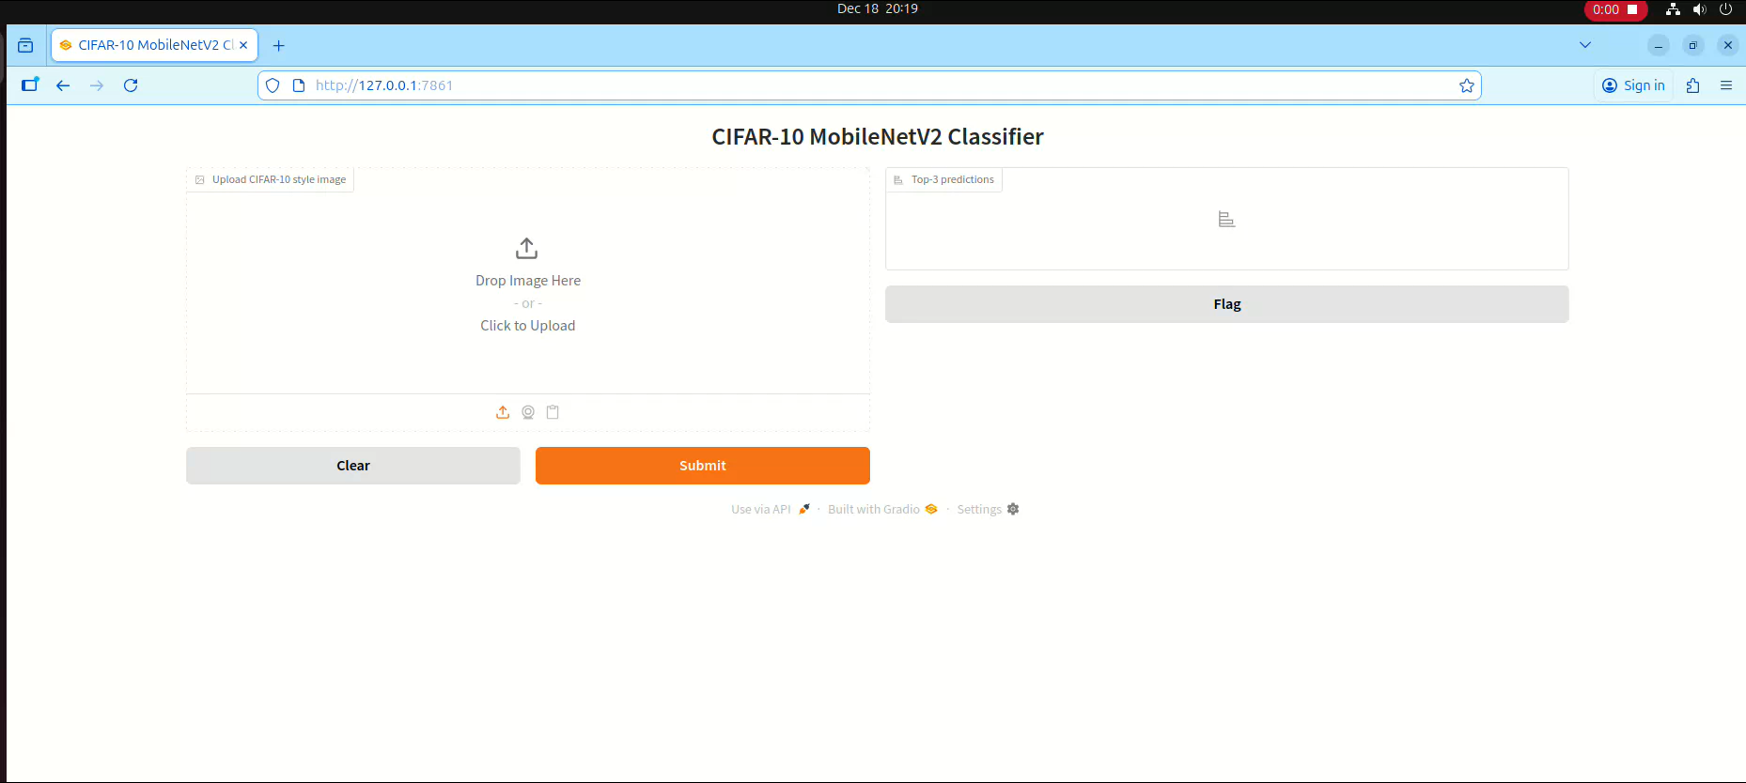
Inferencing

Slide 16
Conclusion
Scalability and Usability: The Distributed AI Model Training system demonstrates high scalability by efficiently leveraging MPI and GPU acceleration on an HPC environment. The use of PyTorch Distributed Data Parallel enables the model to scale across multiple GPUs and nodes while maintaining stable performance and accuracy.
Operational Efficiency: By parallelizing the training process, the system significantly reduces overall training time compared to serial CPU and single-GPU execution.
Reliability and Accuracy: The distributed approach maintains comparable classification accuracy to serial training, ensuring that performance gains are achieved without compromising model quality.
Partial Impact and Usability: The integration of a Gradio-based inference interface demonstrates how HPC-trained models can be deployed for real-world usage.

Slide 17
References
Books and Articles:
Sandler, M., Howard, A., Zhu, M., Zhmoginov, A., & Chen, L.-C. (2018). MobileNetV2: Inverted Residuals and Linear Bottlenecks. IEEE Conference on Computer Vision and Pattern Recognition (CVPR). (For lightweight CNN architecture and efficient deep learning models)
Goyal, P., Dollár, P., Girshick, R., Noordhuis, P., Wesolowski, L., Kyrola, A., & He, K. (2017). Accurate, Large Minibatch SGD: Training ImageNet in 1 Hour. arXiv preprint arXiv:1706.02677. (For distributed data-parallel training concepts)
Online Resources:
PyTorch Official Documentation. (2025). PyTorch Distributed and DDP Guide. Retrieved from https://pytorch.org/docs/stable/distributed.html (Accessed August 2025)

Slide 18
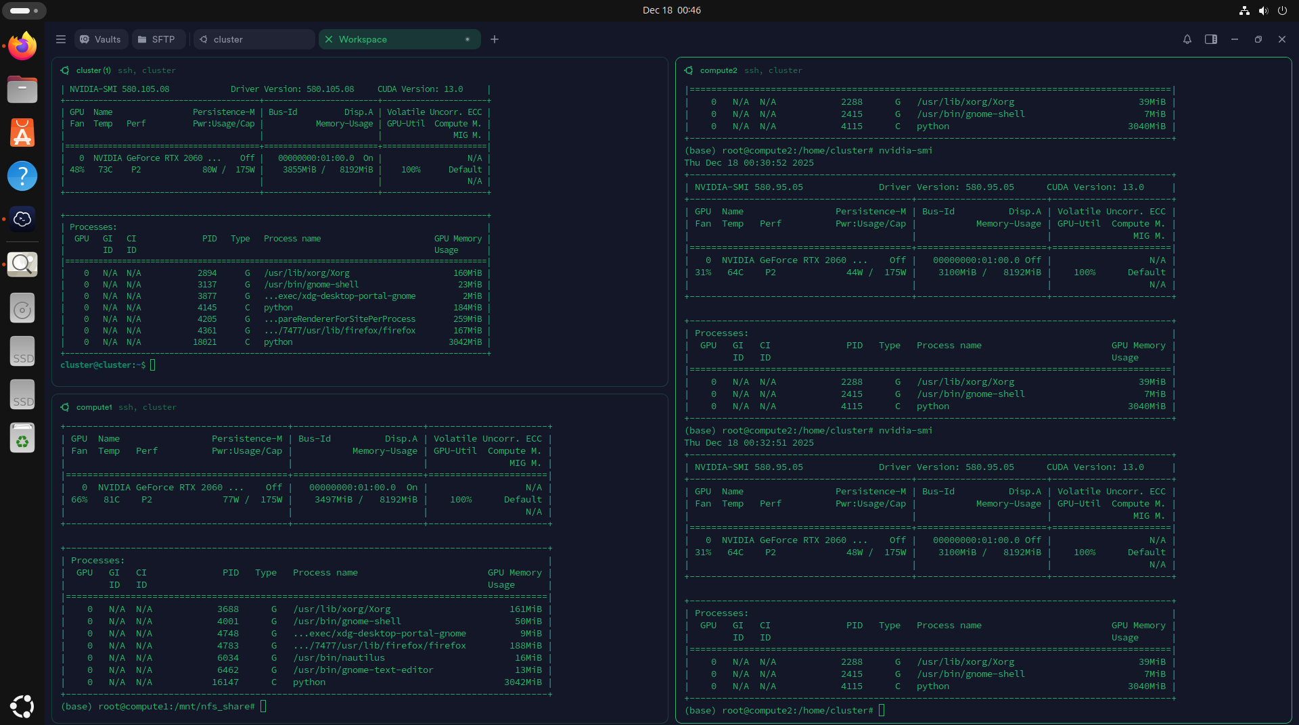
Cluster

Slide 19
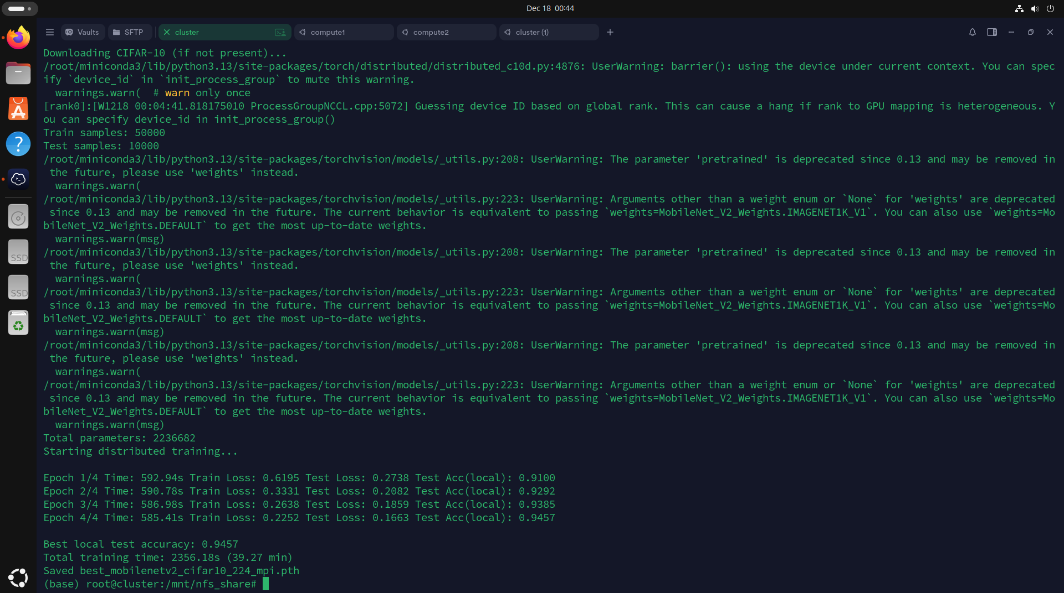
Cluster

Slide 20
THANK YOU

